Slide 1
Testing Concepts
Lesson 1: Fundamentals of Testing

Slide 2
Lesson Objectives
To understand the following topics:
Some Facts about Software Systems
What is Testing?
Typical Objectives of Testing
Testing and Debugging
Why is Testing Necessary?
Testing’s Contributions to Success
Quality Assurance and Testing
Errors, Defects, and Failures - Reasons behind Errors
Defects, Root Causes and Effects
Cost of Software Defects
Importance of Testing Early in SDLC phases

Slide 3
Lesson Objectives
Seven Testing Principles
Economic of Testing
Scope of Software Testing
Factors influencing Software Testing
Test Process
Test Process in Context
Test Activities and Tasks
Test Work Products
Traceability between the Test Basis and Test Work Products
The Psychology of Testing
Human Psychology and Testing
− Attributes of a good Tester
− Code of Ethics for Tester
Tester’s and Developer’s Mindsets
Limitations of Software Testing

Slide 4
Some Facts about Software Systems !!
Software systems are an integral part of life, from business
applications (e.g., banking) to consumer products (e.g., cars).
Most people have had an experience with software that did not work as expected.
Software that does not work correctly can lead to many problems, including loss of money, time, or business reputation, and even injury or death.
Examples :
Excel gives 77.1 x 850 = 100000 instead of 65535
Y2K problem in Payroll systems designed in 1974
Disney’s Lion King – Simba

Slide 5
1.1 What is Testing ?
Software testing is a way to assess the quality of the software and to
reduce the risk of software failure in operation.
Misperceptions of Testing :
Testing only consists of running tests i.e. executing the software and checking the results. But, software testing is a process which includes many different activities and test execution is just one of these activities. The test process includes activities such as test planning, analyzing, designing, implementing and executing the tests, reporting test progress and results, and evaluating the quality of a test object.
Testing focuses entirely on verification of requirements, user stories, or other specifications. But, testing also involves checking whether the system meets specified requirements, it also involves validation, which is checking whether the system will meet user and other stakeholder needs in its operational environment(s).

Slide 6
1.1 What is Testing ? (Cont.)
Testing involves both Dynamic testing and Static testing.
Testing that involves the execution of the component or system being tested; such testing is called dynamic testing.
Testing that involves the reviewing of work products such as requirements, user stories, and source code; such testing is called static testing.
Test activities are organized and carried out differently in different lifecycles, explained in lesson 2.

Slide 7
1.1.1
Objectives of Software Testing
To evaluate work products such as requirements, user stories, design,
and code
To verify whether all specified requirements have been fulfilled
To validate whether the test object is complete and works as the users
and other stakeholders expect
To build confidence in the level of quality of the test object
To prevent defects
To find failures and defects in the Software before User finds it
To provide sufficient information to stakeholders to allow them to make informed decisions, especially regarding the level of quality of the test object.

Slide 8
1.1.1
Objectives of Software Testing (Cont.)
To reduce the level of risk of inadequate software quality (e.g., previously undetected failures occurring in operation) and contribute to the delivery of higher quality software product
To comply with contractual, legal, or regulatory requirements or standards, and/or to verify the test object’s compliance with such requirements or standards
Objectives of testing can vary, depending upon the context of the component or system being tested, the test level, and the software development lifecycle model.

Slide 9
Software Testing - Definitions
The process of executing a program (or part of a program) with the
intention of finding errors - G. J. Myers
Software testing is the process of testing the functionality and correctness of software by running it
Testing is the process of exercising or evaluating a system or system component by manual or automated means to verify that it satisfies specified requirements - IEEE 83a
The process of analyzing a system to detect the difference between existing and required conditions and to evaluate the feature of the system - IEEE/ANSI, 1983 [Std 829-1983]

Slide 10
1.1.2
Testing and Debugging
Testing and debugging are different.
Executing tests can show failures that are caused by defects in the software.
Debugging is the development activity that finds, analyzes, and fixes
such defects.
Subsequent confirmation testing checks whether the fixes have resolved
the defects.
In some cases, testers are responsible for the initial test and the final confirmation test, while developers do the debugging and associated component testing.
However, in Agile development and in some other lifecycles, testers may
be involved in debugging and component testing.

Slide 11
1.2 Why is Software Testing necessary ?
Rigorous testing of components and systems, and their associated documentation, can help reduce the risk of failures occurring during operation.
When defects are detected, and subsequently fixed, this contributes to
the quality of the components or systems.
Software testing is also required to meet contractual or legal requirements or industry-specific standards.
SDLC consists of many stages and if bugs are caught in the earlier stages
it costs much less to fix them. This saves money and time.
Software testing provides product security – the user gets a trustworthy product.
Customer satisfaction - Software Testing helps in bringing out the best user experience possible.

Slide 12
1.2.1 Testing’s Contributions to Success
Use of appropriate test techniques applied with the appropriate level of test expertise, in the appropriate test levels, and at the appropriate points in the SDLC can reduce the frequency of problematic deliveries.
Examples :
Testers involved in requirements reviews reduces the risk of incorrect functionality being developed.
Testers working closely with system designers reduces the risk of fundamental design defects.
Testers working closely with developers reduces the risk of defects within the
code and the tests.
Testers verifying and validating the software prior to release can detect failures that increases the likelihood that the software meets stakeholder needs and satisfies requirements.
Achievement of defined test objectives contributes to the success of overall
software development and maintenance.

Slide 13
1.2.2
Quality Assurance and Testing
Quality Assurance (QA) and Testing are not the same, but they are
related - Quality management, ties them together.
Quality management includes both quality assurance and quality
control.

Slide 14
Quality Assurance and Testing (Cont.)
1.2.2
Quality Assurance | Quality Control
It is an preventive approach – prevents the faults from occurring by providing rules and methods. | It is a corrective approach – corrects the faults when they occur.
It is a task conducted in the process. | It is a task conducted on the product.
Gives confidence to customer. | Gives confidence to producer.
It is a set of planned and systematic set of activities that provides adequate confidence and assures that the product conforms to specified requirements. | It is the process by which product quality is compared with applicable standards and appropriate action is taken when non-conformance is detected.
Entire team (designers, coders, testers, etc.) is responsible for QA. | Only tester is responsible for QC.
Examples : use of CASE (engineering) and CAST (testing) tools, training and | Examples: Walkthrough, inspections, etc.

Slide 15
1.2.3
Errors, Defects and Failures
A person can make an error (mistake), which can lead to the introduction of a defect (fault or bug) in the software code or in some other related work product.
An error that leads to the introduction of a defect in one work product can trigger an error that leads to the introduction of a defect in a related work product.
Example :
A requirements elicitation error can lead to a requirements defect, which then results in a programming error that leads to a defect in the code. If a defect in the code is executed, this may cause a failure, but not necessarily in all circumstances. For example, some defects require very specific inputs or preconditions to trigger a failure, which may occur rarely or never.

Slide 16





1.2.3
Errors, Defects and Failures (Cont.)
Error(Mistake): A human action that produces an incorrect result
Fault: A stage caused by an error which leads to unintended functionality of
the program
Bug: It is an evidence of the fault. It causes the program to perform in unintended manner. It is found before application goes into beta version
Failure: Inability of the system to perform functionality according to its
requirement
Defect: It is a mismatch of the actual and expected result identified while testing the software in the beta version
Error
Fault
Bug
Failure
Defect

Slide 17
Reasons behind Errors
Time pressure
Human fallibility
Inexperienced or insufficiently skilled project participants
Miscommunication between project participants, including miscommunication about requirements and design
Complexity of the code, design, architecture, the underlying problem to be
solved, and/or the technologies used
Misunderstandings about intra-system and inter-system interfaces, especially when such intra-system and inter-system interactions are large in number
New, unfamiliar technologies
Environmental conditions - for example, radiation, electromagnetic fields, and pollution can cause defects in firmware or influence the execution of software by changing hardware conditions.

Slide 18
1.2.4 Defects, Root Causes and Effects
The root causes of defects are the earliest actions or conditions that
contributed to creating the defects.
Defects can be analyzed to identify their root causes.
By focusing on most significant root causes, root cause analysis can lead to
process improvements that prevent future defects from being introduced.
Example :
Suppose incorrect interest payments, due to a single line of incorrect code, results in customer complaints. The defective code was written for a user story which was ambiguous, due to the product owner’s misunderstanding of how to calculate interest. Therefore, it means that :
customer complaints – effects
incorrect interest payments – failures
improper calculation in the code – defect
lack of knowledge on the part of the product owner - root cause of this defect
Due to lack of knowledge, Product owner makes a mistake while writing user story.

Slide 19
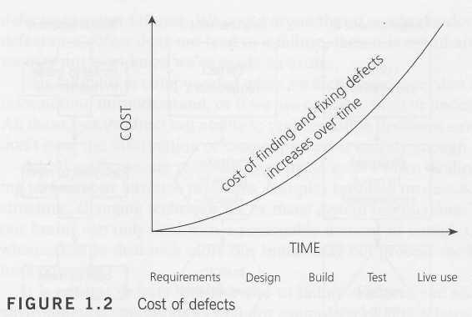
Cost of Software Defects
It is Easy to find and fix defect in early stages rather than in the later phases of software.

Slide 20
Importance of Testing Early in SDLC Phases
Prevents future Problems thus lowering the cost
Testing will not be a bottleneck anymore
Testers become more familiar with the software, as they are more
involved with the evolution of the product.
Reduces the chances of failure
The test environment can be prepared in advance
The risk of having a short time for testing is greatly reduced
Maintains “quality culture” in the organization

Slide 21
1.3 Seven Testing Principles
Principle 1 - Testing shows presence of defects, not their absence
Principle 2 - Exhaustive testing is impossible Principle 3 - Early testing saves time and money Principle 4 - Defects Cluster together
Principle 5 – Beware of the Pesticide Paradox Principle 6 - Testing is context dependent Principle 7 - Absence of Errors is fallacy

Slide 22
Economics of Testing
Economics of Testing
It is both the driving force and the limiting factor
Driving - Earlier the errors are discovered and removed in the lifecycle,
lowers the cost of their removal.
Limiting - Testing must end when the economic returns cease to make it worth while i.e. the costs of testing process significantly outweigh the returns

Slide 23
Scope of Software Testing
Bad news Good news Bad news
: You can’t test everything
: There is such a thing as “good enough”
: Good enough may cost too much
What do we do : Increase focus via systematic process of elimination
What you might test?
Those areas which are within the scope of your project
What you should test?
The critical system functionality which effects the customers & users experience of
quality
What you can test?
Estimate time & resource for risk driven effort

Slide 24
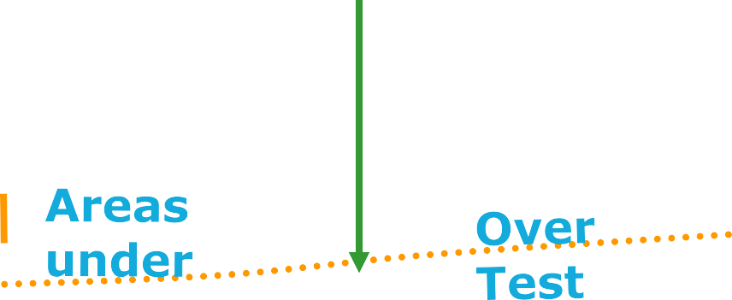

Scope of Software Testing
“Understanding risk is the key to Optimum testing”
Test critical
quality risks
Optimum Test
Cost of
Testing

Slide 25
Factors influencing the Scope of Testing
Contractual requirements
Legal requirements
Privacy related laws
Non-disclosure of identity
Industry-specific requirements
Aircraft safety equipment
Scope of Testing is about identifying the correct test cases for automation
The steps involved are:
Identify various factors that form the basis of identifying the candidate test cases
Apply ‘Divide & rule’ strategy : Break the application into smaller modules
Analyze each module to identify the candidate test cases
Calculate ROI
Factors influencing the scope of testing :
In small projects
Test case writing Test case execution Regression testing
In Large projects
Setting up test bed
Generating test data, test scripts, etc.

Slide 26
1.4 Test Process
Testing is a process rather than a single activity.
The quality and effectiveness of software testing is primarily determined by the quality of the test processes used.
The activities of testing can be divided into the following basic steps:
Planning and Control
Analysis and Design
Implementation and Execution - Evaluating and Reporting
Test Completion/Closure activities

Slide 27
1.4.1 Test Process in Context
The proper, specific software test process in any given situation depends on many factors.
Few of the Contextual factors that influence the test process are :
SDLC model and project methodologies being used
Test levels and test types being considered
Product and project risks
Business domain
Operational constraints that include :
Budgets and resources
Timescales
Complexity
Contractual and regulatory requirements
Organizational policies and practices
Required internal and external standards

Slide 28
1.4.1
Test Process in Context (Cont.)
The following sections describe general aspects of organizational test
processes in terms of the following:
Test activities and tasks
Test work products
Traceability between the test basis and test work products
It is very useful if the test basis (for any level or type of testing that is being
considered) has measurable coverage criteria defined.
The coverage criteria can act effectively as key performance indicators (KPIs) to drive the activities that demonstrate achievement of software test objectives (defined in section 1.1.1).

Slide 29
1.4.2
Test Activities and Tasks
Test planning
Test monitoring and control
Test analysis
Test design
Test implementation
Test execution
Test completion

Slide 30
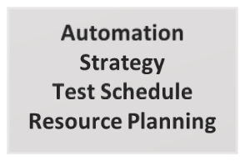
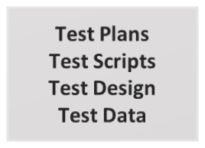
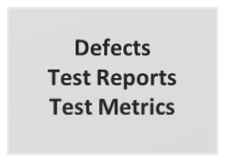
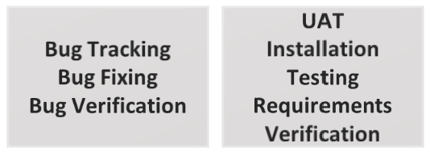
Software testing life cycle
Test Strategy
Test Development
Test Execution
Defect Management
Delivery
TS
TD
TE
DM
D

Slide 31
Test Planning
Test planning involves activities that define the testing objectives (refer section 1.1.1) and the approach for meeting test objectives within constraints imposed by the context.
For example, specifying suitable test techniques and tasks, and
formulating a test schedule for meeting a deadline.
Test plans may be revisited based on feedback obtained from monitoring and control activities.

Slide 32
Test Monitoring and Control
Test monitoring involves an on-going comparison of actual progress against the test plan using any test monitoring metrics defined in the test plan.
Test control involves taking actions necessary to meet the objectives of
the test plan.
Test monitoring and control are supported by the evaluation of exit
criteria.
For example, the evaluation of exit criteria for test execution as part of a given test level may include:
Checking test results and logs against specified coverage criteria
Assessing the level of component or system quality based on test results and logs
Determining if more tests are needed (e.g., if tests originally intended to achieve a certain level of product risk coverage failed to do so, requiring additional tests to be written and executed)

Slide 33
Test Analysis
Test analysis determines “what to test” in terms of measurable coverage
criteria.
Test analysis includes the following major activities:
Analyzing the test basis appropriate to the test level being considered.
Requirement specifications, such as business requirements, functional requirements, system requirements, user stories, epics, use cases, or similar work products that specify desired functional and non-functional component or system behavior
Design and implementation information, such as system or software architecture diagrams or documents, design specifications, call flows, modelling diagrams (e.g., UML or ER diagrams), interface specifications, or similar work products that specify component or system structure
The implementation of the component or system itself, including code, database metadata and queries, and interfaces
Risk analysis reports, which may consider functional, non-functional, and structural aspects of the component or system

Slide 34
Test Analysis (Cont.)
Evaluating the test basis and test items to identify defects of various
types, such as:
Ambiguities
Omissions
Inconsistencies
Inaccuracies
Contradictions
Superfluous statements

Slide 35
Test Analysis (Cont.)
Identifying features and sets of features to be tested
Defining and prioritizing test conditions for each feature based on analysis of the test basis, and considering functional, non-functional, and structural characteristics, other business and technical factors, and levels of risks
Capturing bi-directional traceability between each element of the test basis and the associated test conditions (see sections 1.4.3 and 1.4.4)

Slide 36
Test Design
During test design, the test conditions are elaborated into high-level test cases, sets of high-level test cases, and other testware. So, test analysis answers the question “what to test?” while test design answers the question “how to test?”
Test design includes the following major activities:
Designing and prioritizing test cases and sets of test cases
Identifying necessary test data to support test conditions and test cases
Designing the test environment and identifying any required
infrastructure and tools
Capturing bi-directional traceability between the test basis, test
conditions, test cases, and test procedures (see section 1.4.4)
The elaboration of test conditions into test cases and sets of test cases
during test design often involves using test techniques (see chapter 4).

Slide 37
Test Implementation
During test implementation, the testware necessary for test
execution is created and/or completed, including sequencing the test cases into test procedures.
Test design answers the question “how to test?” while test implementation answers the question “do we now have everything in place to run the tests?”

Slide 38
Test Implementation (Cont.)
Test implementation includes the following major activities:
Developing and prioritizing test procedures, and, potentially, creating automated test scripts
Creating test suites from the test procedures and automated test scripts
Arranging the test suites within a test execution schedule in a way that
results in efficient test execution (see section 5.2.4)
Building the test environment (including, potentially, test harnesses, service virtualization, simulators, and other infrastructure items) and verifying that everything needed has been set up correctly
Preparing test data and ensuring it is properly loaded in the test
environment
Verifying and updating bi-directional traceability between the test basis, test conditions, test cases, test procedures, and test suites (see section 1.4.4)

Slide 39
Test Execution
During test execution, test suites are run in accordance with the test execution schedule.
Test execution includes the following major activities:
Recording the IDs and versions of the test item(s) or test object, test tool(s), and testware
Executing tests either manually or by using test execution tools
Comparing actual results with expected results
Analyzing anomalies to establish their likely causes (e.g., failures may occur due to defects in the code, but false positives also may occur (see section 1.2.3))
Reporting defects based on the failures observed (see section 5.6)
Logging the outcome of test execution (e.g., pass, fail, blocked)
Repeating test activities either as a result of action taken for an anomaly, or as part of the planned testing (e.g., confirmation testing, or regression testing)
Verifying and updating bi-directional traceability between the test
basis, test conditions, test cases, test procedures, and test results.

Slide 40
Test Completion
Test completion includes the following major activities:
Checking whether all defect reports are closed, entering change requests or product backlog items for any defects that remain unresolved at the end of test execution
Creating a test summary report to be communicated to stakeholders
Finalizing and archiving the test environment, the test data, the test
infrastructure, and other testware for later reuse
Handing over the testware to the maintenance teams, other project teams, and/or other stakeholders who could benefit from its use
Analyzing lessons learned from the completed test activities to
determine changes needed for future iterations, releases, and projects
Using the information gathered to improve test process maturity.

Slide 41
1.4.3
Test Work Products
Test work products are created as part of the test process. Many of the test work products can be captured and managed using test management tools and defect management tools (see chapter 6).
Test planning work products
Test monitoring and control work products
Test analysis work products
Test design work products
Test implementation work products
Test execution work products
Test completion work products

Slide 42
1.4.4 Traceability between Test Basis and Test Work Products
It is important to establish and maintain traceability throughout the test process between each element of the test basis and the various test work products associated with it.
In addition to the evaluation of test coverage, good traceability supports:
Analyzing the impact of changes
Making testing auditable
Meeting IT governance criteria
Improving the understandability of test progress reports and test summary reports to include the status of elements of the test basis (e.g., requirements that passed their tests, requirements that failed their tests, and requirements that have pending tests)
Relating the technical aspects of testing to stakeholders in terms that they can
understand
Providing information to assess product quality, process capability, and project progress against business goals.

Slide 43
Attributes of a good Tester
A good test engineer has a 'test to break' attitude
Need to take a different view, a different mindset (“What if it isn’t?”,
“What could go wrong?”)
An ability to understand the point of view of the customer
A passion for quality and attention to detail
Notice little things that others miss/ignore (See symptom not bug)
Ability to communicate fault information to both technical (developers) and non-technical (managers and customers)
Tact and diplomacy for maintaining a cooperative relationship with developers
Work under worst time pressure (at the end)
“Patience”

Slide 44
1.5 Psychology of Testing
Identifying defects during a static test or identifying failures during dynamic test execution, was perceived as criticism of the product and of its author.
Since developers expect their code to be correct, they have a confirmation bias that makes it difficult to accept that the code is incorrect.
As a result of these psychological factors, some people may perceive testing as a destructive activity, even though it contributes greatly to project progress and product quality
To try to reduce these perceptions and tensions between the testers and the analysts, product owners, designers, and developers, the information about defects and failures should be communicated in a constructive way.

Slide 45
1.5.1 Human Psychology and Testing
Testers and test managers need to have good interpersonal skills to be able to communicate effectively about defects, failures, test results, test progress, and risks, and to build positive relationships with colleagues.
Ways to communicate well include the following examples:
Start with collaboration rather than battles. Remind everyone of the common
goal of better quality systems.
Emphasize on the benefits of testing. For example, for the authors, defect information can help them improve their work products and their skills. For the organization, defects found and fixed during testing will save time and money and reduce overall risk to product quality.
Communicate test results and other findings in a neutral, fact-focused way without criticizing the author.
Confirm that the other person has understood what has been said and vice
versa.
Clearly defining the right set of test objectives.

Slide 46
Code of Ethics for Tester
Involvement in software testing enables individuals to learn confidential and privileged information. A code of ethics is therefore necessary, among other reasons to ensure that the information is not put to inappropriate use.
PUBLIC - Tester shall act consistently with public interest
CLIENT AND EMPLOYER - Tester shall act in best interests of their client and employer
PRODUCT - Tester shall ensure that the deliverables they provide meet highest
professional standards possible
JUDGMENT - Tester shall maintain integrity and independence in their professional
judgment
MANAGEMENT - Tester managers and leaders shall subscribe to and promote an
ethical approach to manage software testing
PROFESSION - Tester shall advance the integrity and reputation of the profession
consistent with the public interest
COLLEAGUES - Tester shall be fair to and supportive of their colleagues, and promote cooperation with software developers
SELF - Tester shall participate in lifelong learning and shall promote an ethical approach to the practice of the profession

Slide 47
1.5.2
Tester’s and Developer’s Mindsets
Developers and testers often think differently. Bringing these mindsets together helps to achieve a higher level of product quality.
A mindset reflects an individual’s assumptions and preferred methods for
decision making and problem solving.
A tester’s mindset should include curiosity, professional pessimism, a critical eye, attention to detail, and a motivation for good and positive communications and relationships.
A tester’s mindset tends to grow and mature as the tester gains experience.
A developer’s mindset may include designing and building solutions than in
contemplating what might be wrong with those solutions.
In addition, confirmation bias makes it difficult to find mistakes in their own
work. With the right mindset, developers are able to test their own code.
Having some of the test activities done by independent testers increases defect detection effectiveness, which is particularly important for large, complex, or safety-critical systems.

Slide 48
Limitations of Software Testing
Even if we could generate the input, run the tests, and evaluate the output, we would not detect all faults
Correctness is not checked
The programmer may have misinterpreted the specs, the specs may have
misinterpreted the requirements
There is no way to find missing paths due to coding errors

Slide 49

Summary
In this lesson, you have learnt:
Testing is an extremely creative & intellectually challenging
task
No software exists without bug
Testing is conducted with the help of users requirements, design documents, functionality, internal structures & design, by executing code
Scope of testing
The cost of not testing is potentially much higher
Testing is in a way a destructive process
A successful test case is one that brings out an error in
program
Various principles of testing

Slide 50

Review Question
Question 1: What is visible to end-users is a deviation from the specific or expected behavior is called as
Defect
Bug
Failure
Fault
Question 2: is a planned sequence of actions.
Question 3: Pick the best definition of Quality :
Quality is job done
Zero defects
Conformance to requirements
Work as designed
Question 4: One cannot test a program completely to guarantee that it is error free (T/F)
Question 5: One can find missing paths due to coding errors (T/F)

